Slide 1
Food
Vocabulary

Slide 2
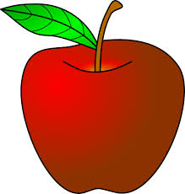
Fruit
apple
bananas
oranges
grapes

Slide 3
Fruit
Do you like apples?
Do you like bananas?
Does Sarah like oranges?
Does Charles like grapes?
Yes, he likes grapes.

Slide 4
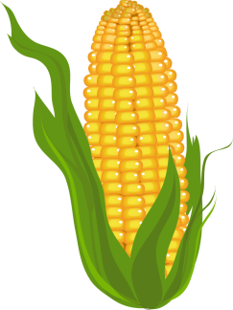
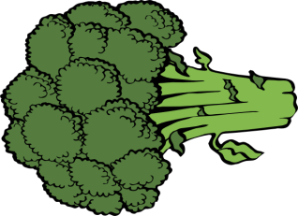
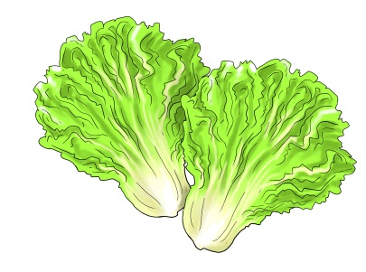
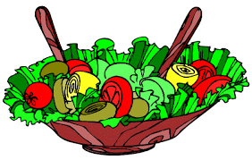
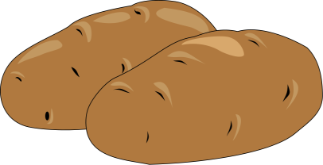
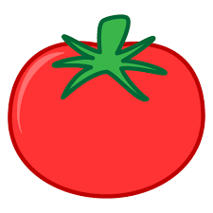
Vegetables
carrot
corn
broccoli
lettuce
salad
potato
tomato

Slide 5
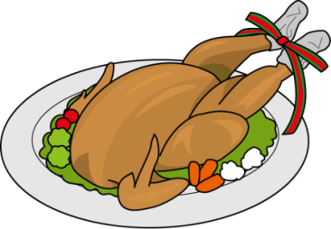
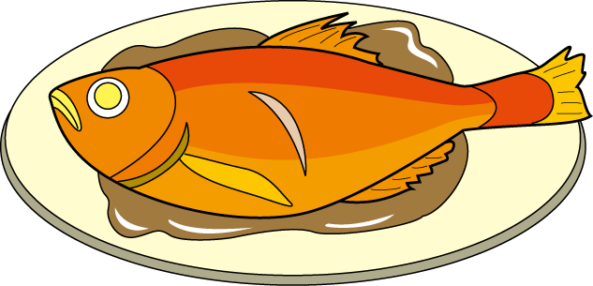
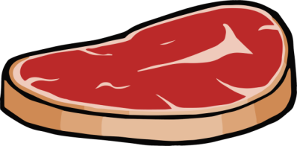
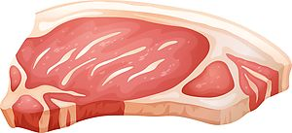
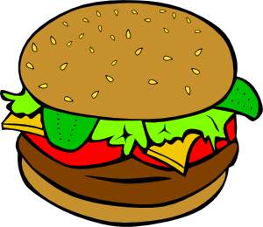
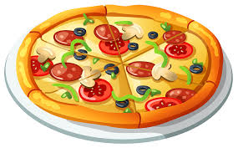
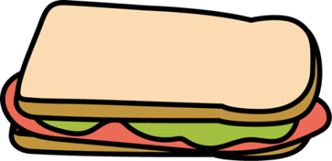
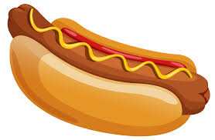
Meat
chicken
fish
pork
beef
pizza
hamburger
sandwich
beans
hot dog

Slide 6
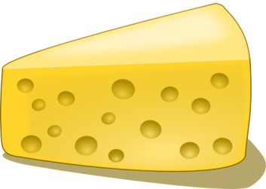
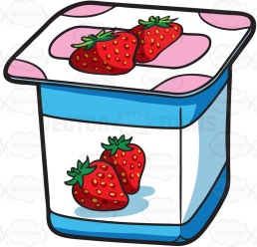
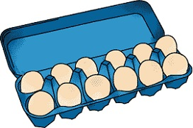
Dairy
cheese
butter
yogurt
milk
eggs
juice

Slide 7
Dessert
Charles likes ice cream.
Do you like ice cream?
Sarah likes cake. Do you like cake?
I like cookies. Do you like cookies?
ice cream
cake
cookies

